Slide 1

Variance of immigrant earnings
Capstone Project
Syed Atef Alvi

Slide 2
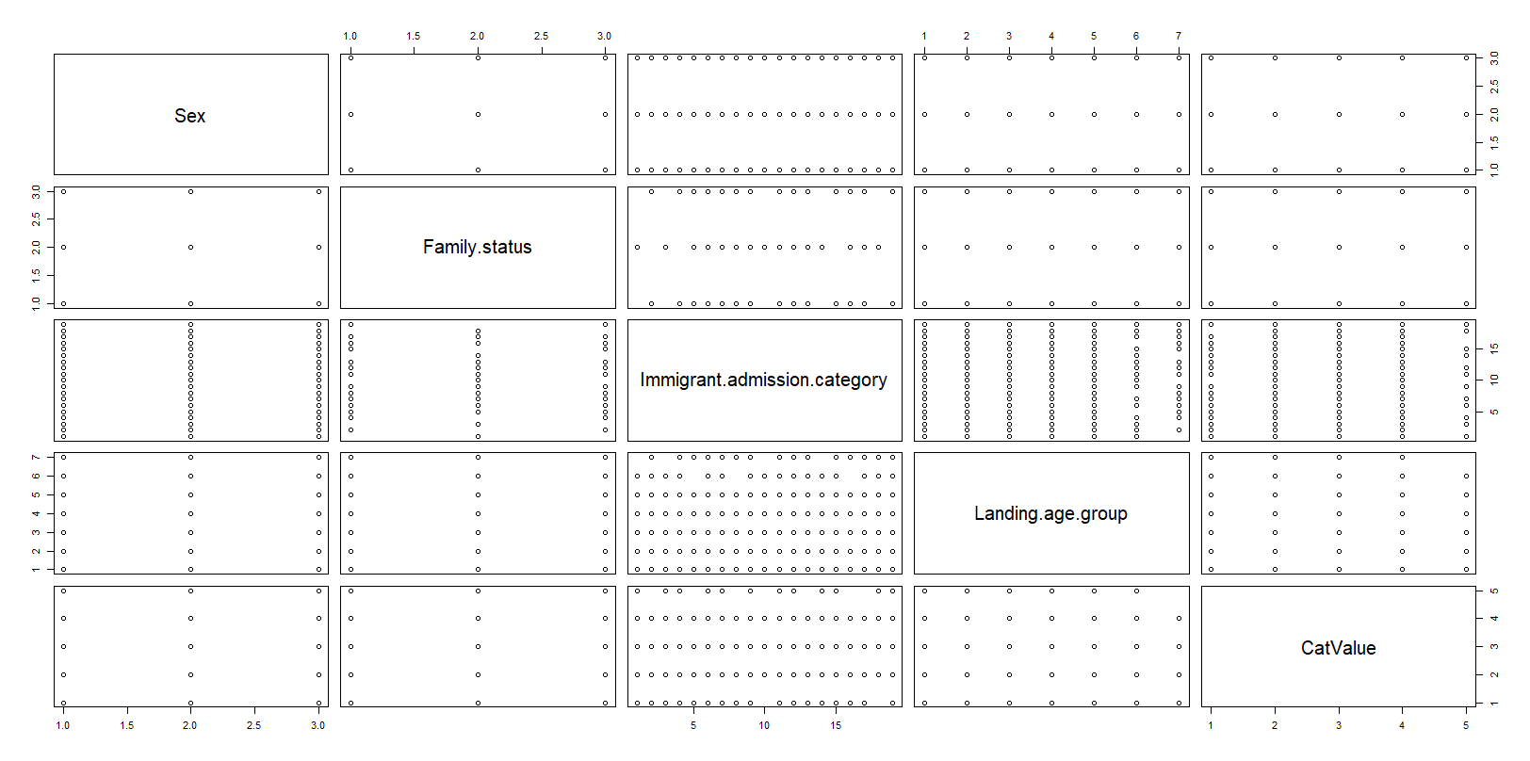
Data distribution

Slide 3
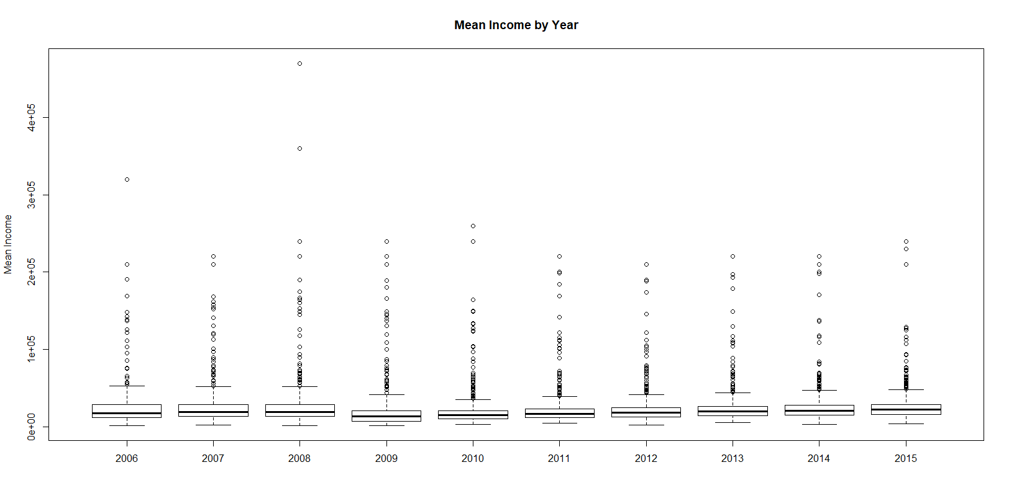
CatValue vs Year

Slide 4
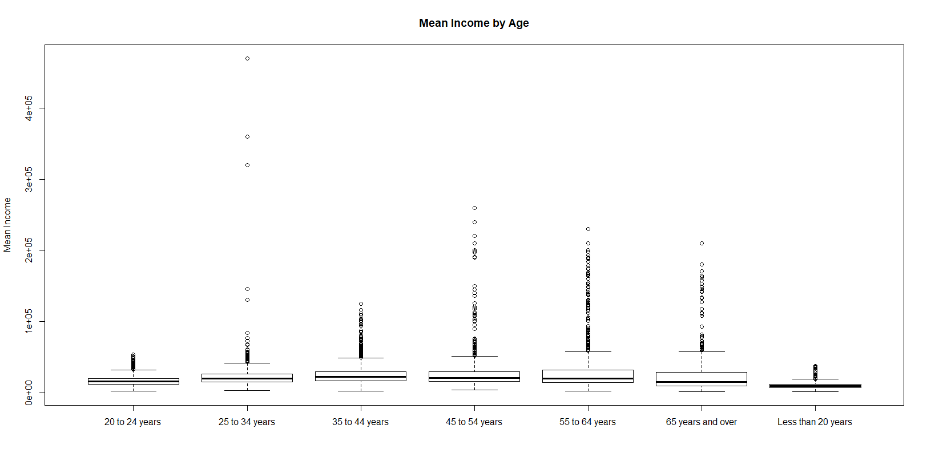
CatValue vs Age Group

Slide 5
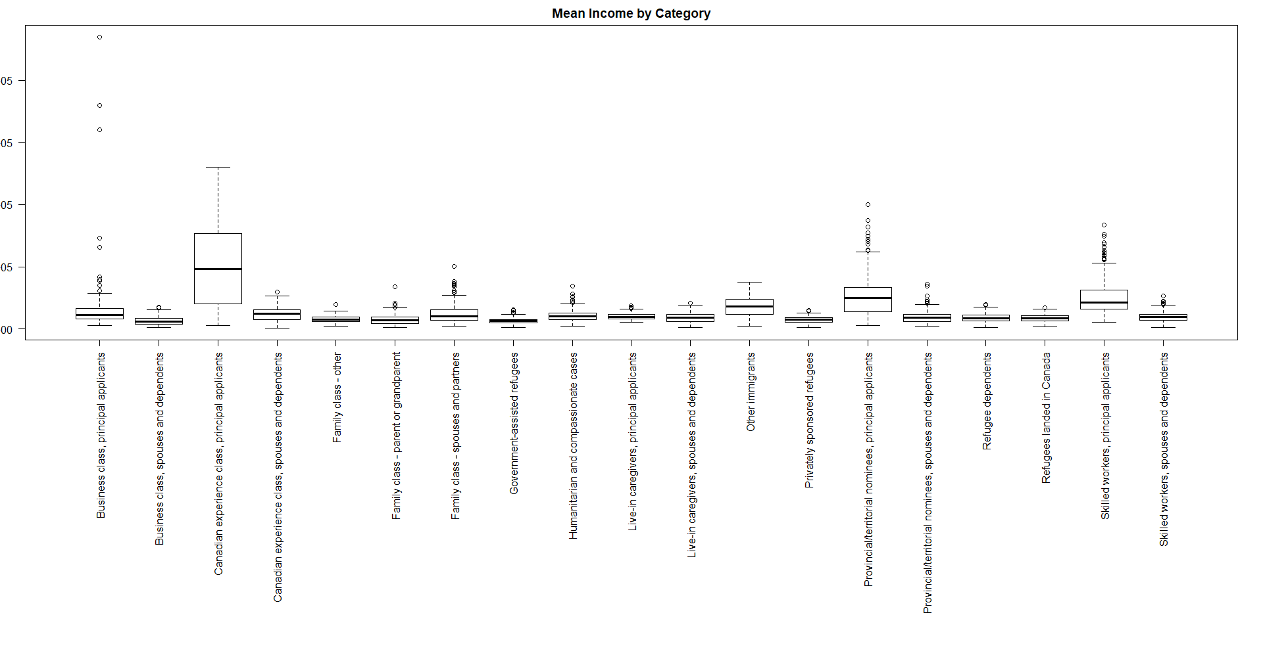
CatValue vs Immigration Category

Slide 6
Apriori Low Income Rules
Rule | LHS | Support | Confidence | Lift | Count
1 | Sex=Females Family.status=Dependents Landing.age.group=Less than 20 years | 0.01245406 | 0.622449 | 6.049117 | 61

Slide 7
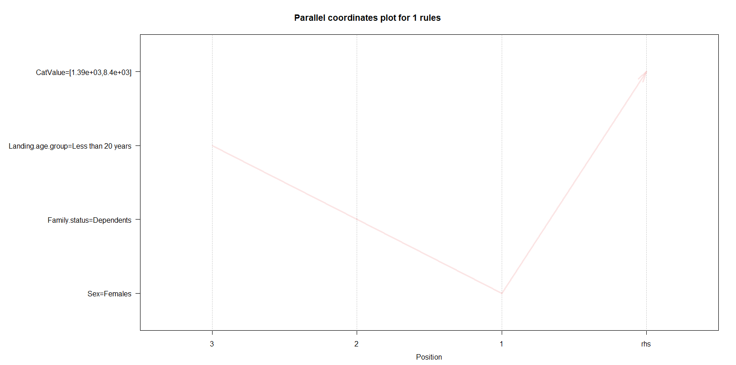
Apriori Low Income Rules

Slide 8
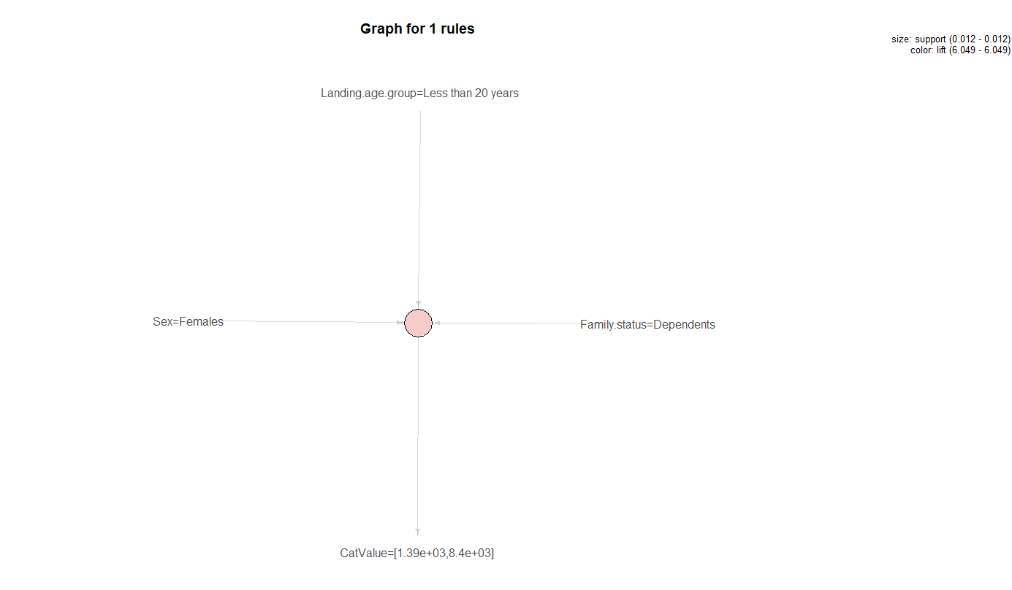
Apriori Low Income Rules

Slide 9
Apriori High Income Rules
Rule | LHS | Support | Confidence | Lift | Count
1 | Immigrant.admission.category = Canadian experience class, principal applicants | 0.02613312 | 0.7356322 | 7.41384 | 128
2 | Immigrant.admission.category = Skilled workers, principal applicants | 0.02062066 | 0.5401070 | 5.44330 | 101
3 | Family.status = Principal applicants Immigrant.admission.category = Canadian experience class, principal applicants | 0.02613312 | 0.7356322 | 7.41384 | 128
4 | Family.status = Principal applicants Immigrant.admission.category = Skilled workers, principal applicants | 0.02062066 | 0.5401070 | 5.44330 | 101

Slide 10
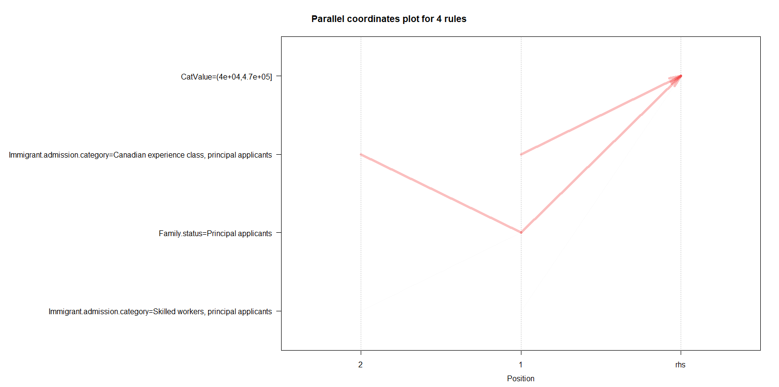
Apriori High Income Rules

Slide 11
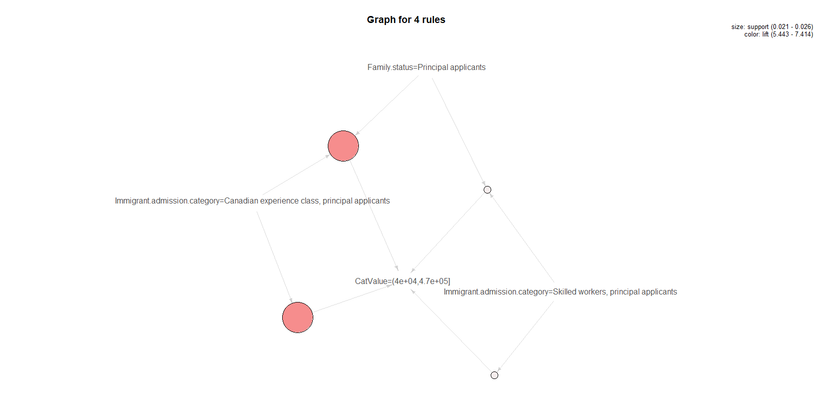
Apriori High Income Rules

Slide 12
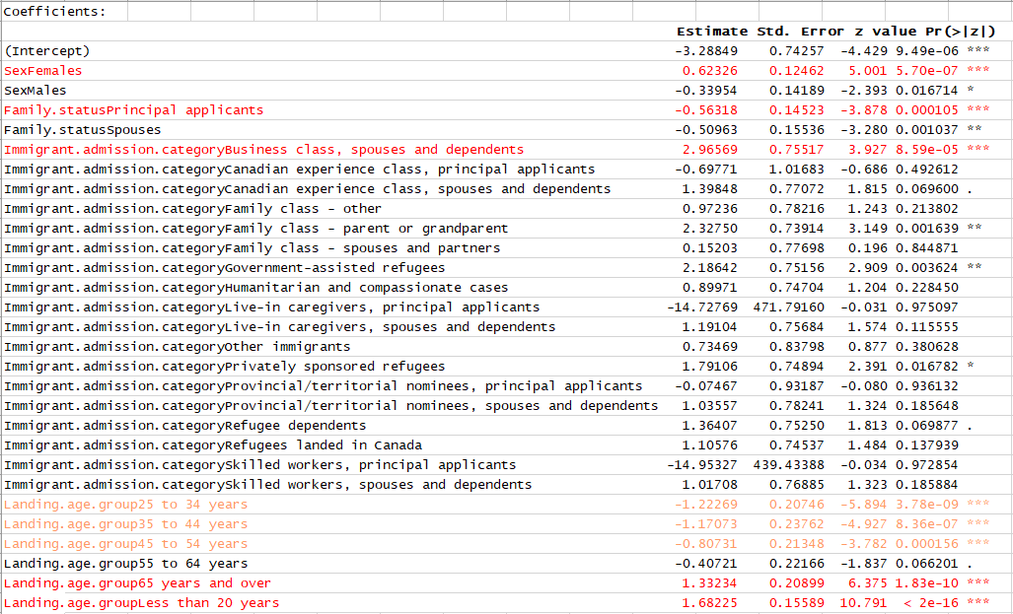
Binomial Low Income Rules

Slide 13
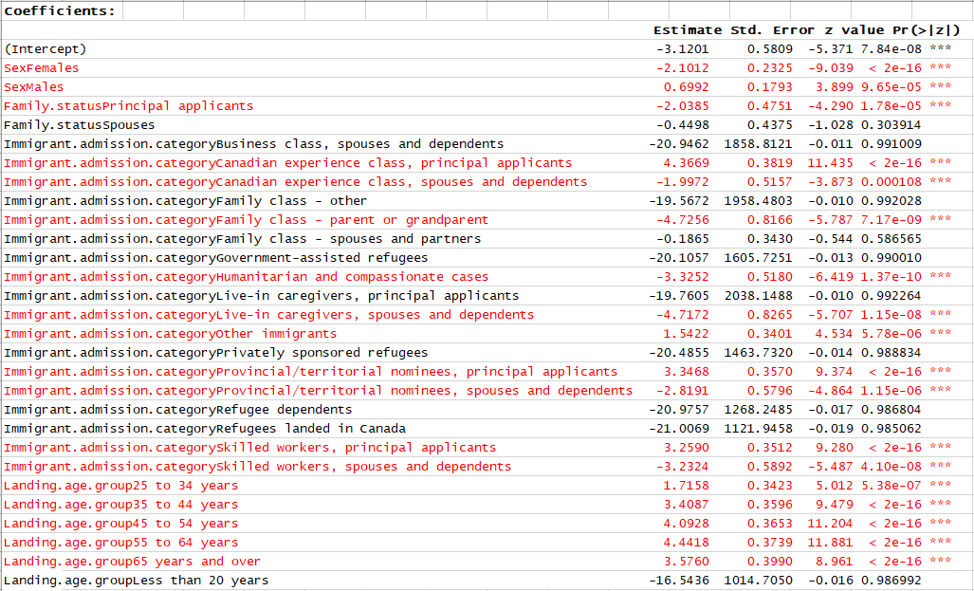
Binomial High Income Rules

Slide 14
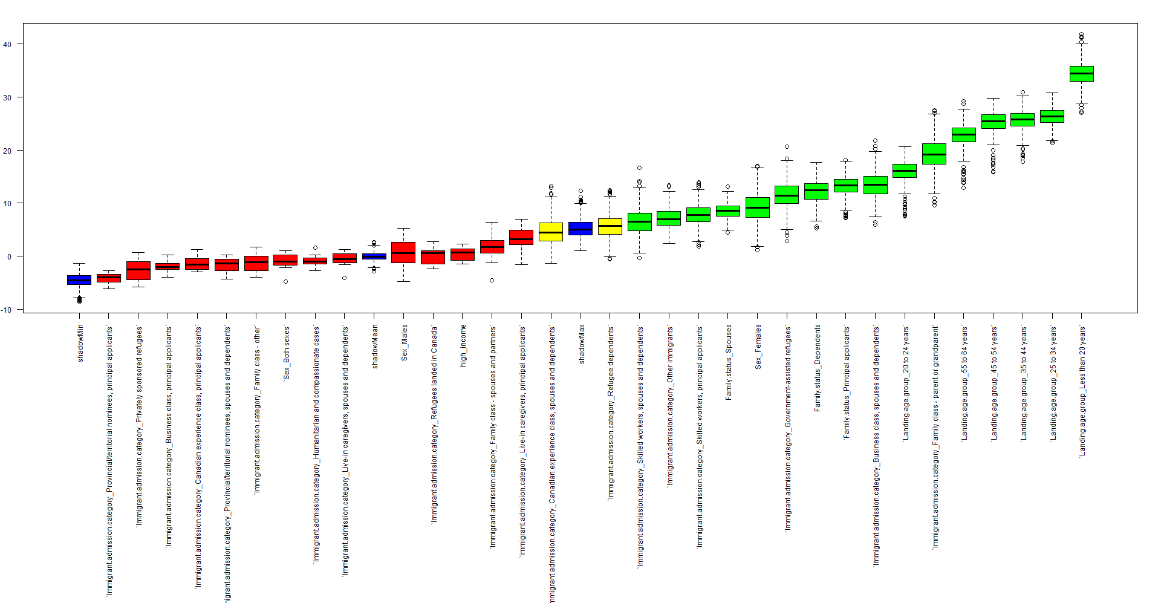
Boruta – Low Income

Slide 15
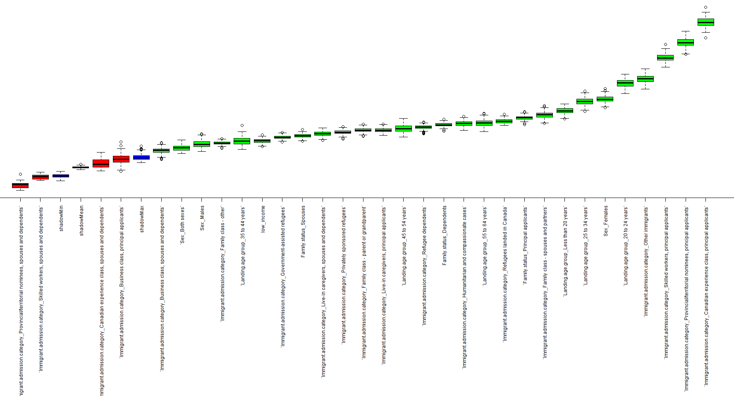
Boruta – High Income

